Slide 1
DECK MAP — HIDDEN (do not present)
TL1 L1 — Git for the Team Platformer. Blank Office Theme master (BC adds formatting/logo). Tutorial-heavy: 3 live follow-alongs.
PRE-LECTURE (TL1): create the MAIN PROJECT repo with a blank README in each teammate's directory (locked; no code until System's Analysis). Team + all-TL Discords were set up at the Meet & Greet.
ORDER: Title · Intros(+LEC-for-Git note) · TOC · Why one repo · TWO REPOS TWO JOBS · FA1 create+gitignore+base · FA2 conflict drill (TEAM.md) · FA3 README in locked repo · everyday loop · commands · What to hand in · How it runs in TL2 L2 (+TL1 earns LEC).
TWO REPOS: PLATFORMER repo = live work, conflicts welcome, CODEOWNERS does NOT apply. MAIN PROJECT repo = locked, README-only proof of access.
IN L2, NOT HERE: CODEOWNERS, directory-audit, commit-as-alibi, recovery (revert/reset/reflog), CI/CD. L1 only forward-points to these.
NOTE MODES: word-for-word spoken on non-tutorial slides; 'YOU MUST ACCOMPLISH / IF YOU DON'T KNOW HOW' brief on the 3 follow-along slides. Follow-along slides show key commands as a reference (slide not projected during the live demo).
Name

Slide 2
Sit with your TL# group
Front Of Room
TL3s
+ KC (a TL5)
TL4s
+ Rinab ( a TL6)
TL1s
The remaining TL5s and TL6s

Slide 3
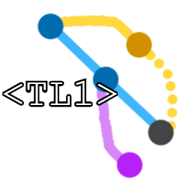
Git for the Team Platformer
· TL1 — Lecture 1 ·
Create the repo.
Load the base.
Commit your features.
Adam
Notes:
[SPOKEN]
"Welcome. This is the first TL1 lecture, and it's the most hands-on one you'll get from us — because Git is not something you learn by watching. You learn it by doing it, breaking it, and fixing it. So today you're not going to sit and take notes while I talk about version control. You're going to create a repository, push to it, pull from it, and deliberately crash into a merge conflict and climb back out — all live, on your own machines, following along with us.
By the end of this hour you'll have done every core Git move at least once. That's the goal: not that you've heard of these commands, but that you've run them."
[Then to the introductions slide with the whole TL1 group up front.]

Slide 4
Meet Your TL1 Team
We are your TL1 group — everyone across the class who shares TL number 1.
Each of us will introduce ourselves by name.
While one of us presents, the rest are circulating to help you set up Git.
Special: during the TL2 lecture, a TL1 can earn a support credit (LEC) for helping ANY team with a Git push / pull / merge problem — so flag us down all semester.
Adam
Notes:
[SPOKEN — whole TL1 group up front; each says their name so the class can flag them by name.]
"First, quick introductions — you'll be calling on us by name all hour."
[Each TL1 says name + team.]
"Here's something worth knowing: while one of us presents, the rest are moving around the room to help you get set up. And we are highly motivated to help — each of us needs to log support interactions this semester, and helping you is the easiest way to earn them. So when Git does something confusing — and it will — put your hand up. You're doing us a favor by asking.
One more thing, and this is special to TL1: our job doesn't end when this lecture does. During the TL2 lecture, when your team is pushing features to the repo and something goes wrong with a push or a pull or a merge — any TL1 can come help you, and we earn a support credit for it. Normally only the team that's presenting earns those. TL1 is the exception, precisely because Git problems happen to everyone, all semester. So all semester long: if it's a Git problem, grab a TL1. We're looking for the work."
[This LEC-for-Git-help exception is also stated in the TL2 deck so the class hears it there too.]

Slide 5
What We'll Do Today
1 Why the team needs one shared repository
2 Two repos, two very different jobs
3 Follow Along 1: create the platformer repo (+ .gitignore) and load the base game
4 Follow Along 2: cause and resolve merge conflicts (TEAM.md)
5 Follow Along 3: prove you can reach the locked project repo
6 The everyday loop, what to hand in, and how this runs during TL2
Adam
Notes:
[SPOKEN]
"Here's the plan. First, why the team needs one shared repository at all. Then an important distinction — we actually deal with TWO repositories today, and they have very different rules, so I'll make sure you know which is which.
Then the hands-on core: three follow-alongs. One, we create the platformer repository together, add a .gitignore, and load the starting game. Two — and this is the one everyone remembers — we all edit the same file on purpose and walk through resolving the merge conflicts that causes. Three, you'll prove you can reach the locked main project repo by updating your README.
Then we'll name the everyday loop you'll repeat all semester, cover how you hand work in from now on, and finish with how all of this gets used during the TL2 lecture.
The middle part — the three follow-alongs — is where you'll spend most of the hour, laptops open."]

Slide 6
Why One Shared Repo
Your TL cohort is building ONE platformer together.
Everyone adds at least one feature — and those features must merge into a single game.
Git lets several people contribute at once without overwriting each other's work.
TL1's job: set up the repo and teach the flow the rest of the team will use.
Adam
Notes:
[SPOKEN]
"Start with the why. Your TL cohort — all of you who share a TL number — are building ONE platformer together. Each of you will add at least one feature, and all those features have to end up in a single game. That's the problem Git solves: it lets several people work on the same project at the same time without silently overwriting each other's work.
Without Git, team coding is emailing zip files around and hoping — someone always ends up pasting their work over someone else's and losing an afternoon. With Git, everyone works from the same source of truth, and the tool keeps track of who changed what.
TL1's job — your job — is to set up that repository and teach the rest of the team the handful of moves they'll use every day. That's what today is."]

Slide 7
Two Repos, Two Jobs
PLATFORMER repo — our live workspace. Push, pull, and (on purpose today) hit merge conflicts. The one-directory ownership rule does NOT apply here.
MAIN PROJECT repo — your real project. Already set up, and LOCKED: no project code until the System's Analysis passes.
Today you touch the main repo for ONE thing: update your own README, to prove you can reach it.
All hands-on practice happens in the PLATFORMER repo. Don't run the drills on the locked repo.
Adam
Notes:
[SPOKEN — this slide prevents the whole class from running the drills on the locked repo. Say it clearly.]
"Before we touch anything, one distinction that will save you a lot of confusion: today we work with TWO different repositories, and they have opposite rules.
The first is the PLATFORMER repo. This is our live workspace today, and later it's where the TL2 lecture builds the game. Here, we push and pull freely, and — this is deliberate — we are GOING to hit merge conflicts, because that's the whole point of one of today's exercises. The one-directory ownership rule you'll hear about later does NOT apply to this repo. It's a shared working space.
The second is the MAIN PROJECT repo — your actual course project. I've already set it up before class, and it is LOCKED. No project code goes into it until your System's Analysis passes. Today you touch it for exactly one reason: to update your own README, proving you can reach it. That's it.
So keep them straight: all the hands-on Git practice happens in the PLATFORMER repo. The main project repo gets one README edit and nothing else. Don't run the drills on the locked repo."]

Slide 8
Recap: What is GIT?
Version control for your repository
Track changes in source code and files over time
Allows for multiple developers to work on the same project, without overwriting each other's work
Chris
Notes:
[SPOKEN — this slide prevents the whole class from running the drills on the locked repo. Say it clearly.]
"Before we touch anything, one distinction that will save you a lot of confusion: today we work with TWO different repositories, and they have opposite rules.
The first is the PLATFORMER repo. This is our live workspace today, and later it's where the TL2 lecture builds the game. Here, we push and pull freely, and — this is deliberate — we are GOING to hit merge conflicts, because that's the whole point of one of today's exercises. The one-directory ownership rule you'll hear about later does NOT apply to this repo. It's a shared working space.
The second is the MAIN PROJECT repo — your actual course project. I've already set it up before class, and it is LOCKED. No project code goes into it until your System's Analysis passes. Today you touch it for exactly one reason: to update your own README, proving you can reach it. That's it.
So keep them straight: all the hands-on Git practice happens in the PLATFORMER repo. The main project repo gets one README edit and nothing else. Don't run the drills on the locked repo."]

Slide 9
Recap: Basic GIT commands
git clone: Copy a remote repository to your local machine.
git add: Stage selected changes in you working tree. Will be included in your next commit.
git commit: Save a snapshot of the staged changes with a message.
Chris
Notes:
[SPOKEN — this slide prevents the whole class from running the drills on the locked repo. Say it clearly.]
"Before we touch anything, one distinction that will save you a lot of confusion: today we work with TWO different repositories, and they have opposite rules.
The first is the PLATFORMER repo. This is our live workspace today, and later it's where the TL2 lecture builds the game. Here, we push and pull freely, and — this is deliberate — we are GOING to hit merge conflicts, because that's the whole point of one of today's exercises. The one-directory ownership rule you'll hear about later does NOT apply to this repo. It's a shared working space.
The second is the MAIN PROJECT repo — your actual course project. I've already set it up before class, and it is LOCKED. No project code goes into it until your System's Analysis passes. Today you touch it for exactly one reason: to update your own README, proving you can reach it. That's it.
So keep them straight: all the hands-on Git practice happens in the PLATFORMER repo. The main project repo gets one README edit and nothing else. Don't run the drills on the locked repo."]

Slide 10
Recap: Basic GIT commands
git push: Sends local commits to the remote repository.
git pull: Fetches new commits from remote branch and merges them with your local branch.
git merge: Takes changes from one branch and integrates them into another branch.
Chris
Notes:
[SPOKEN — this slide prevents the whole class from running the drills on the locked repo. Say it clearly.]
"Before we touch anything, one distinction that will save you a lot of confusion: today we work with TWO different repositories, and they have opposite rules.
The first is the PLATFORMER repo. This is our live workspace today, and later it's where the TL2 lecture builds the game. Here, we push and pull freely, and — this is deliberate — we are GOING to hit merge conflicts, because that's the whole point of one of today's exercises. The one-directory ownership rule you'll hear about later does NOT apply to this repo. It's a shared working space.
The second is the MAIN PROJECT repo — your actual course project. I've already set it up before class, and it is LOCKED. No project code goes into it until your System's Analysis passes. Today you touch it for exactly one reason: to update your own README, proving you can reach it. That's it.
So keep them straight: all the hands-on Git practice happens in the PLATFORMER repo. The main project repo gets one README edit and nothing else. Don't run the drills on the locked repo."]

Slide 11
The Everyday Commands
git pull # get the latest
# ...add your feature, test it...
git add . # stage changes
git commit -m "Add <feature>" # save a snapshot
git push # share with the team
# Clear messages: "Add enemy", "Add coins", "Add HUD"
# so the history reads like the feature list.
Chris
Notes:
[SPOKEN]
"Here are the actual commands, and this is the exact flow the TL2 lecture will point you to every time you add a feature. There are really only four you use constantly.
git pull to get the latest. Then you do your work and test it. git add to stage your changes. git commit with a clear message to snapshot it. git push to share it with the team.
One thing I want to nag you about: the commit message. Write something real — 'Add enemy,' 'Add coins,' 'Add HUD' — so that when anyone reads the project history it reads like the feature list. 'asdf' or 'stuff' or 'fixed it' tells no one anything, and later this semester your commit history becomes evidence at your oral exam. Make it read like a story of what you built."]

Slide 12
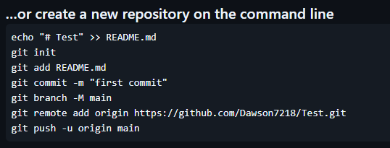
Follow Along 1 — Create the Platformer Repo
# TL1 creates ONE platformer repo, adds teammates as collaborators.
# Everyone clones it, then BEFORE the first push:
# add a Unity .gitignore at the repo root.
git clone <repo-url>
git add .gitignore
git commit -m "Add Unity .gitignore"
git push
# TL1 copies in the chosen base platformer, then:
git add .
git commit -m "Add base platformer (best Lecture-1 build)"
git push
# Everyone else:
git pull
Dawson
Notes:
[FOLLOW-ALONG BRIEF — near-blank in the room; walk the class through it live. Slide shows the commands as a reference but is NOT projected during the demo.]
YOU MUST ACCOMPLISH (how you'll know you covered everything BC wants):
- ONE platformer repo exists for the cohort, with every teammate added as a collaborator (everyone can push).
- Everyone has cloned it locally.
- A Unity .gitignore is committed at the repo root BEFORE any Unity project files are pushed. (This is the step that prevents committing gigabytes of Library/Temp junk and the merge nightmares that follow.)
- The chosen "best Lecture-1 platformer" is pushed as the base.
- Every teammate has pulled, so the whole cohort starts from the identical base.
- Each person writes a clear commit message (habit starts now: "Add Unity .gitignore", not "asdf").
IF YOU DON'T ALREADY KNOW HOW:
- Creating a repo + collaborators: GitHub -> New repository; Settings -> Collaborators. Search "GitHub add collaborator to repository".
- .gitignore for Unity: DON'T write one by hand. Use GitHub's template (choose "Unity" when creating the repo) or grab the official one — search "Unity .gitignore github/gitignore". Ask the AI: "What belongs in a Unity .gitignore and why?"
- Clone/add/commit/push: search "git clone add commit push tutorial" or use GitHub Desktop (search "GitHub Desktop clone commit push") if the class prefers a GUI.
- WHY .gitignore first: search "Unity git commit Library folder problem" to see what goes wrong without it.

Slide 13
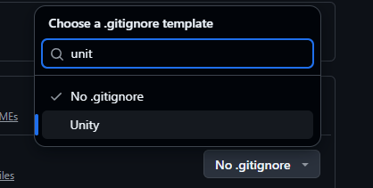
Follow Along 1 — Create the Platformer Repo
# TL1 creates ONE platformer repo, adds teammates as collaborators.
# Everyone clones it, then BEFORE the first push:
# add a Unity .gitignore at the repo root.
git clone <repo-url>
git add .gitignore
git commit -m "Add Unity .gitignore"
git push
# TL1 copies in the chosen base platformer, then:
git add .
git commit -m "Add base platformer (best Lecture-1 build)"
git push
# Everyone else:
git pull
Dawson
Notes:
[FOLLOW-ALONG BRIEF — near-blank in the room; walk the class through it live. Slide shows the commands as a reference but is NOT projected during the demo.]
YOU MUST ACCOMPLISH (how you'll know you covered everything BC wants):
- ONE platformer repo exists for the cohort, with every teammate added as a collaborator (everyone can push).
- Everyone has cloned it locally.
- A Unity .gitignore is committed at the repo root BEFORE any Unity project files are pushed. (This is the step that prevents committing gigabytes of Library/Temp junk and the merge nightmares that follow.)
- The chosen "best Lecture-1 platformer" is pushed as the base.
- Every teammate has pulled, so the whole cohort starts from the identical base.
- Each person writes a clear commit message (habit starts now: "Add Unity .gitignore", not "asdf").
IF YOU DON'T ALREADY KNOW HOW:
- Creating a repo + collaborators: GitHub -> New repository; Settings -> Collaborators. Search "GitHub add collaborator to repository".
- .gitignore for Unity: DON'T write one by hand. Use GitHub's template (choose "Unity" when creating the repo) or grab the official one — search "Unity .gitignore github/gitignore". Ask the AI: "What belongs in a Unity .gitignore and why?"
- Clone/add/commit/push: search "git clone add commit push tutorial" or use GitHub Desktop (search "GitHub Desktop clone commit push") if the class prefers a GUI.
- WHY .gitignore first: search "Unity git commit Library folder problem" to see what goes wrong without it.

Slide 14

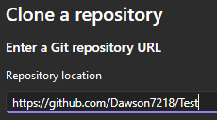
Follow Along 1 — Create the Platformer Repo
# TL1 creates ONE platformer repo, adds teammates as collaborators.
# Everyone clones it, then BEFORE the first push:
# add a Unity .gitignore at the repo root.
git clone <repo-url>
git add .gitignore
git commit -m "Add Unity .gitignore"
git push
# TL1 copies in the chosen base platformer, then:
git add .
git commit -m "Add base platformer (best Lecture-1 build)"
git push
# Everyone else:
git pull
Dawson
Notes:
[FOLLOW-ALONG BRIEF — near-blank in the room; walk the class through it live. Slide shows the commands as a reference but is NOT projected during the demo.]
YOU MUST ACCOMPLISH (how you'll know you covered everything BC wants):
- ONE platformer repo exists for the cohort, with every teammate added as a collaborator (everyone can push).
- Everyone has cloned it locally.
- A Unity .gitignore is committed at the repo root BEFORE any Unity project files are pushed. (This is the step that prevents committing gigabytes of Library/Temp junk and the merge nightmares that follow.)
- The chosen "best Lecture-1 platformer" is pushed as the base.
- Every teammate has pulled, so the whole cohort starts from the identical base.
- Each person writes a clear commit message (habit starts now: "Add Unity .gitignore", not "asdf").
IF YOU DON'T ALREADY KNOW HOW:
- Creating a repo + collaborators: GitHub -> New repository; Settings -> Collaborators. Search "GitHub add collaborator to repository".
- .gitignore for Unity: DON'T write one by hand. Use GitHub's template (choose "Unity" when creating the repo) or grab the official one — search "Unity .gitignore github/gitignore". Ask the AI: "What belongs in a Unity .gitignore and why?"
- Clone/add/commit/push: search "git clone add commit push tutorial" or use GitHub Desktop (search "GitHub Desktop clone commit push") if the class prefers a GUI.
- WHY .gitignore first: search "Unity git commit Library folder problem" to see what goes wrong without it.

Slide 15
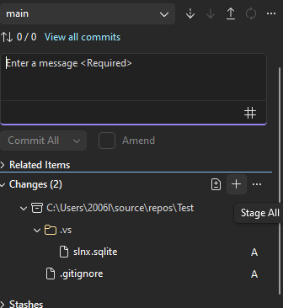
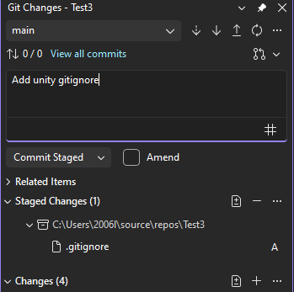
Follow Along 1 — Create the Platformer Repo
# TL1 creates ONE platformer repo, adds teammates as collaborators.
# Everyone clones it, then BEFORE the first push:
# add a Unity .gitignore at the repo root.
git clone <repo-url>
git add .gitignore
git commit -m "Add Unity .gitignore"
git push
# TL1 copies in the chosen base platformer, then:
git add .
git commit -m "Add base platformer (best Lecture-1 build)"
git push
# Everyone else:
git pull
Dawson
Notes:
[FOLLOW-ALONG BRIEF — near-blank in the room; walk the class through it live. Slide shows the commands as a reference but is NOT projected during the demo.]
YOU MUST ACCOMPLISH (how you'll know you covered everything BC wants):
- ONE platformer repo exists for the cohort, with every teammate added as a collaborator (everyone can push).
- Everyone has cloned it locally.
- A Unity .gitignore is committed at the repo root BEFORE any Unity project files are pushed. (This is the step that prevents committing gigabytes of Library/Temp junk and the merge nightmares that follow.)
- The chosen "best Lecture-1 platformer" is pushed as the base.
- Every teammate has pulled, so the whole cohort starts from the identical base.
- Each person writes a clear commit message (habit starts now: "Add Unity .gitignore", not "asdf").
IF YOU DON'T ALREADY KNOW HOW:
- Creating a repo + collaborators: GitHub -> New repository; Settings -> Collaborators. Search "GitHub add collaborator to repository".
- .gitignore for Unity: DON'T write one by hand. Use GitHub's template (choose "Unity" when creating the repo) or grab the official one — search "Unity .gitignore github/gitignore". Ask the AI: "What belongs in a Unity .gitignore and why?"
- Clone/add/commit/push: search "git clone add commit push tutorial" or use GitHub Desktop (search "GitHub Desktop clone commit push") if the class prefers a GUI.
- WHY .gitignore first: search "Unity git commit Library folder problem" to see what goes wrong without it.

Slide 16
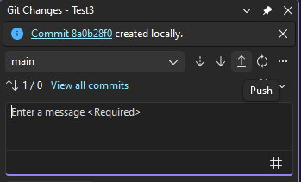
Follow Along 1 — Create the Platformer Repo
# TL1 creates ONE platformer repo, adds teammates as collaborators.
# Everyone clones it, then BEFORE the first push:
# add a Unity .gitignore at the repo root.
git clone <repo-url>
git add .gitignore
git commit -m "Add Unity .gitignore"
git push
# TL1 copies in the chosen base platformer, then:
git add .
git commit -m "Add base platformer (best Lecture-1 build)"
git push
# Everyone else:
git pull
Dawson
Notes:
[FOLLOW-ALONG BRIEF — near-blank in the room; walk the class through it live. Slide shows the commands as a reference but is NOT projected during the demo.]
YOU MUST ACCOMPLISH (how you'll know you covered everything BC wants):
- ONE platformer repo exists for the cohort, with every teammate added as a collaborator (everyone can push).
- Everyone has cloned it locally.
- A Unity .gitignore is committed at the repo root BEFORE any Unity project files are pushed. (This is the step that prevents committing gigabytes of Library/Temp junk and the merge nightmares that follow.)
- The chosen "best Lecture-1 platformer" is pushed as the base.
- Every teammate has pulled, so the whole cohort starts from the identical base.
- Each person writes a clear commit message (habit starts now: "Add Unity .gitignore", not "asdf").
IF YOU DON'T ALREADY KNOW HOW:
- Creating a repo + collaborators: GitHub -> New repository; Settings -> Collaborators. Search "GitHub add collaborator to repository".
- .gitignore for Unity: DON'T write one by hand. Use GitHub's template (choose "Unity" when creating the repo) or grab the official one — search "Unity .gitignore github/gitignore". Ask the AI: "What belongs in a Unity .gitignore and why?"
- Clone/add/commit/push: search "git clone add commit push tutorial" or use GitHub Desktop (search "GitHub Desktop clone commit push") if the class prefers a GUI.
- WHY .gitignore first: search "Unity git commit Library folder problem" to see what goes wrong without it.

Slide 17
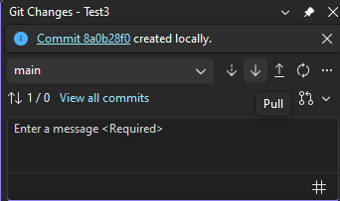
Follow Along 1 — Create the Platformer Repo
# TL1 creates ONE platformer repo, adds teammates as collaborators.
# Everyone clones it, then BEFORE the first push:
# add a Unity .gitignore at the repo root.
git clone <repo-url>
git add .gitignore
git commit -m "Add Unity .gitignore"
git push
# TL1 copies in the chosen base platformer, then:
git add .
git commit -m "Add base platformer (best Lecture-1 build)"
git push
# Everyone else:
git pull
Dawson
Notes:
[FOLLOW-ALONG BRIEF — near-blank in the room; walk the class through it live. Slide shows the commands as a reference but is NOT projected during the demo.]
YOU MUST ACCOMPLISH (how you'll know you covered everything BC wants):
- ONE platformer repo exists for the cohort, with every teammate added as a collaborator (everyone can push).
- Everyone has cloned it locally.
- A Unity .gitignore is committed at the repo root BEFORE any Unity project files are pushed. (This is the step that prevents committing gigabytes of Library/Temp junk and the merge nightmares that follow.)
- The chosen "best Lecture-1 platformer" is pushed as the base.
- Every teammate has pulled, so the whole cohort starts from the identical base.
- Each person writes a clear commit message (habit starts now: "Add Unity .gitignore", not "asdf").
IF YOU DON'T ALREADY KNOW HOW:
- Creating a repo + collaborators: GitHub -> New repository; Settings -> Collaborators. Search "GitHub add collaborator to repository".
- .gitignore for Unity: DON'T write one by hand. Use GitHub's template (choose "Unity" when creating the repo) or grab the official one — search "Unity .gitignore github/gitignore". Ask the AI: "What belongs in a Unity .gitignore and why?"
- Clone/add/commit/push: search "git clone add commit push tutorial" or use GitHub Desktop (search "GitHub Desktop clone commit push") if the class prefers a GUI.
- WHY .gitignore first: search "Unity git commit Library folder problem" to see what goes wrong without it.

Slide 18
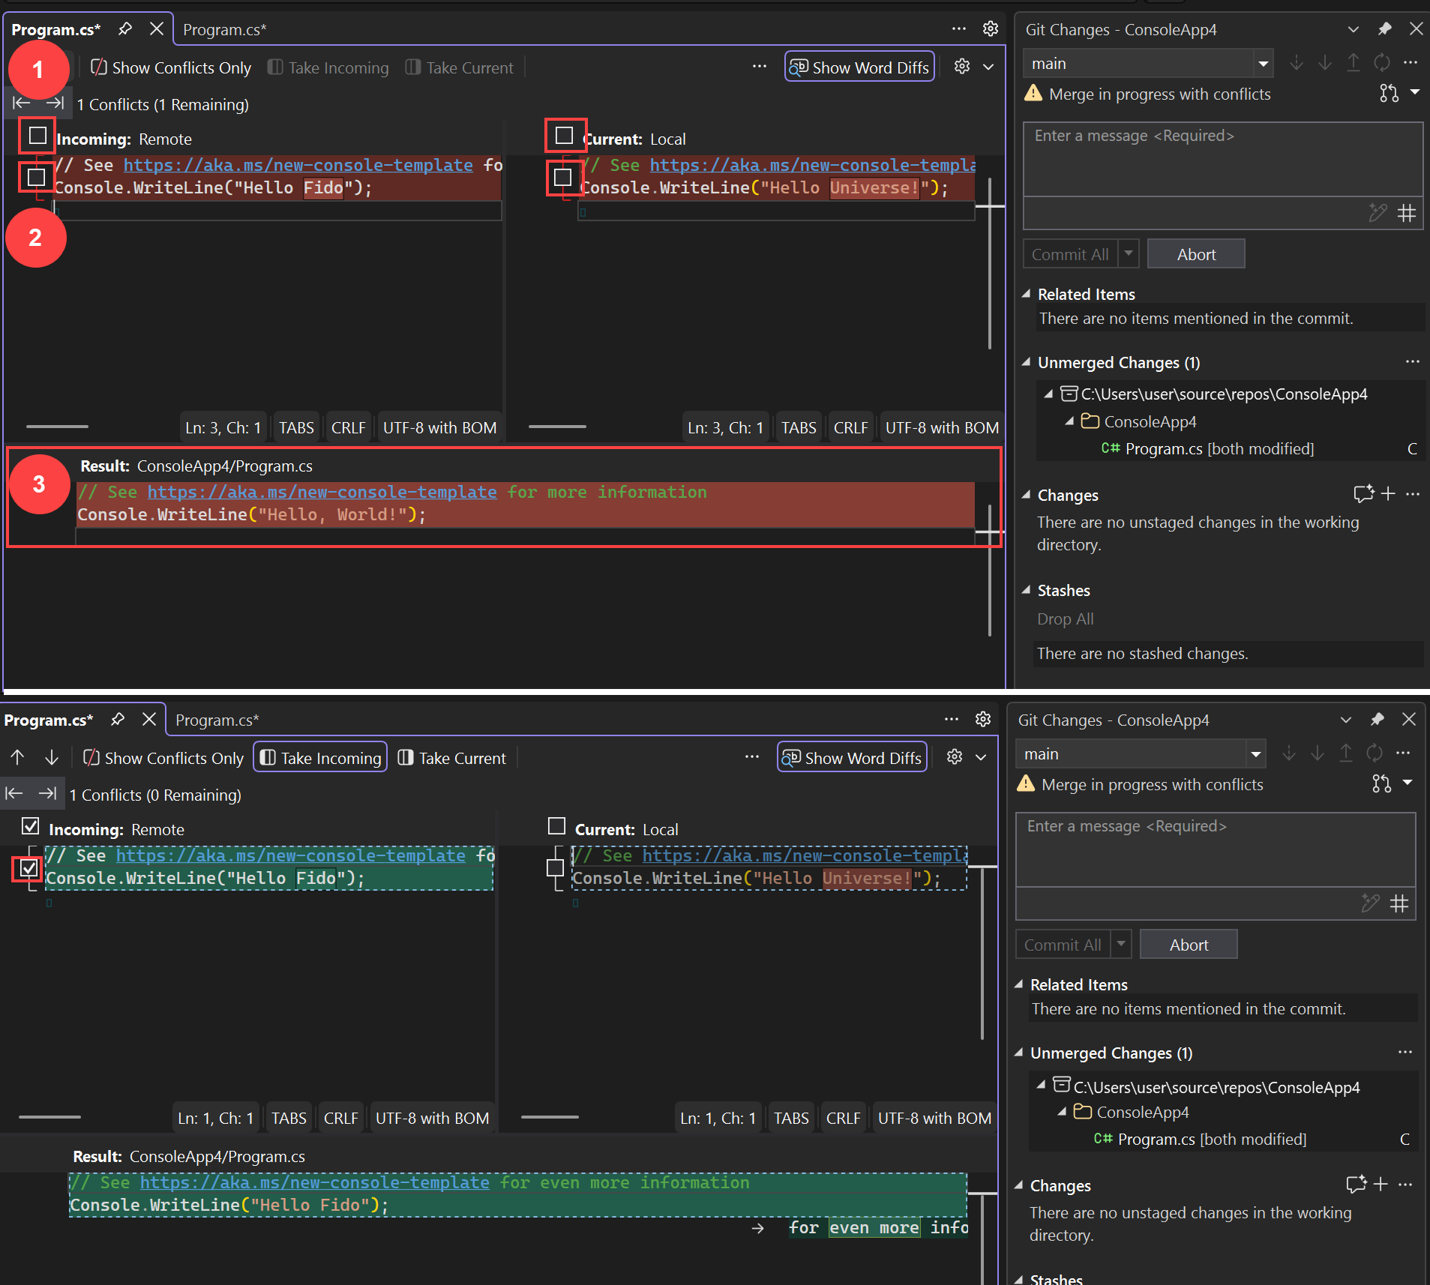
Follow Along 2 — Merge Conflicts on TEAM.md
# In the PLATFORMER repo. One shared file: TEAM.md.
# Go ONE PERSON AT A TIME so everyone hits a real conflict.
git pull # get the latest first
# ...edit the SAME line(s) of TEAM.md...
git add TEAM.md
git commit -m "Add <name> to TEAM.md"
git push # 1st person succeeds
# next person:
git push # REJECTED - remote moved
git pull # now you get the CONFLICT
# ...open TEAM.md, resolve <<<<<<< ======= >>>>>>> markers...
git add TEAM.md
git commit -m "Resolve TEAM.md conflict"
git push
Dawson
Notes:
[FOLLOW-ALONG BRIEF — the one everyone remembers. Run it SEQUENTIALLY so each student genuinely hits and resolves a conflict. In the PLATFORMER repo, on a shared file TEAM.md. CODEOWNERS does not apply here.]
YOU MUST ACCOMPLISH:
- Every student edits the SAME file, TEAM.md, on the same line(s) — e.g. each adds their own name/row.
- Done ONE AT A TIME: first person pushes and succeeds; each next person's push is rejected, they pull, get a real conflict, resolve it, and push. So EVERY student after the first personally resolves a conflict.
- Each student can identify the conflict markers (<<<<<<<, =======, >>>>>>>), edit the file to the correct combined result, remove the markers, then add/commit/push.
- End state: TEAM.md contains everyone's line, cleanly merged, and main is not broken.
IF YOU DON'T ALREADY KNOW HOW:
- Search "git merge conflict resolve tutorial" and "what do <<<<<<< ======= >>>>>>> mean in git". Ask the AI: "Walk me through resolving a git merge conflict in a text file, step by step."
- The mental model to teach: a conflict means two people changed the same lines; Git can't choose, so it shows you BOTH and asks you to produce the final version. You edit the file to what it SHOULD be, delete the markers, then add/commit.
- GUI option: GitHub Desktop and VS Code both have visual conflict resolvers — search "VS Code resolve merge conflict".
TEACHING NOTE: conflicts here are GOOD — you WANT them to happen so students see they're routine and fixable, not scary. Say that out loud.

Slide 19
Follow Along 3 — Prove You Can Reach the Project Repo
# In the MAIN PROJECT repo (the LOCKED one).
# You edit ONLY your own README - nothing else.
git clone <project-repo-url> # if not already cloned
# ...open YOUR directory's README, add a line...
git add <your-dir>/README.md
git commit -m "Confirm access - <name>"
git push
# That's it. No code here until System's Analysis passes.
Breana Sinipete
Notes:
[FOLLOW-ALONG BRIEF — short. In the MAIN PROJECT repo (locked). Purpose is proof-of-access only.]
YOU MUST ACCOMPLISH:
- Every student successfully clones (or pulls) the main project repo.
- Each student edits ONLY their own directory's README (the blank one TL1 seeded before class), adds a line, and pushes.
- Everyone confirms their push landed (check it on GitHub).
- Class understands: this is the ONLY thing that goes into the project repo until the System's Analysis passes — no code yet.
IF YOU DON'T ALREADY KNOW HOW:
- Same clone/add/commit/push flow as Follow Along 1 — this is deliberately a repeat, to cement it on a second repo.
- If a student can't push: it's almost always a permissions/collaborator issue or an auth issue. Search "GitHub permission denied push" / "GitHub authentication token push". This is exactly the kind of problem a circulating TL1 helps with (and earns a LEC for during TL2).
WHY THIS MATTERS: it verifies, today, that every single student can actually reach the repo their whole grade depends on — long before there's any code at stake. Catch access problems now, not in week 8.

Slide 20
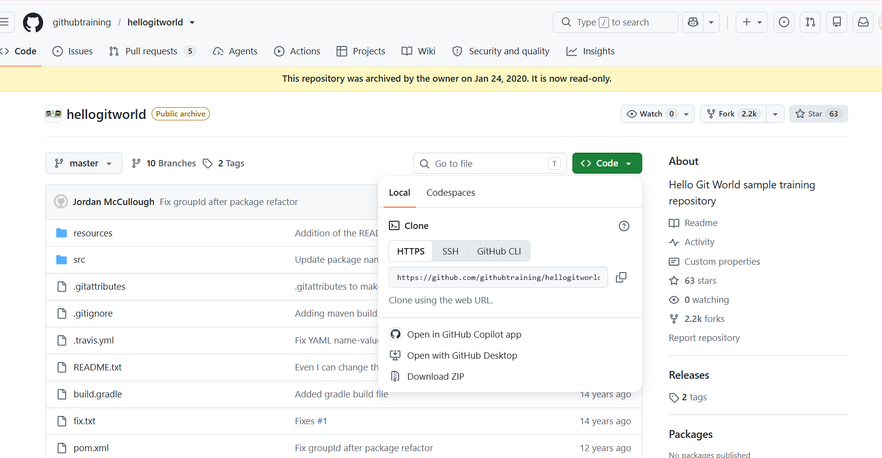
Breana Sinipete
Notes:
[FOLLOW-ALONG BRIEF — short. In the MAIN PROJECT repo (locked). Purpose is proof-of-access only.]
YOU MUST ACCOMPLISH:
- Every student successfully clones (or pulls) the main project repo.
- Each student edits ONLY their own directory's README (the blank one TL1 seeded before class), adds a line, and pushes.
- Everyone confirms their push landed (check it on GitHub).
- Class understands: this is the ONLY thing that goes into the project repo until the System's Analysis passes — no code yet.
IF YOU DON'T ALREADY KNOW HOW:
- Same clone/add/commit/push flow as Follow Along 1 — this is deliberately a repeat, to cement it on a second repo.
- If a student can't push: it's almost always a permissions/collaborator issue or an auth issue. Search "GitHub permission denied push" / "GitHub authentication token push". This is exactly the kind of problem a circulating TL1 helps with (and earns a LEC for during TL2).
WHY THIS MATTERS: it verifies, today, that every single student can actually reach the repo their whole grade depends on — long before there's any code at stake. Catch access problems now, not in week 8.

Slide 21
The Everyday Loop
The loop you repeat for every feature you add:
1 — Pull first, so you're on the latest team version.
2 — Build your feature and TEST it.
3 — Stage → commit (clear message) → push.
4 — If a teammate pushed while you worked: pull, resolve, push. (You just practiced this.)
Breana Sinipete
Notes:
[SPOKEN — reframe as "the loop you just practiced," since they've now done it in FA1/FA2.]
"Everything you just did collapses into one small loop that you'll repeat all semester, for every feature you ever add. Four beats.
Pull first — always start on the latest team version, so you're building on what everyone else has already done. Build your feature and TEST it — never push something you haven't run. Then stage, commit, and push to share it. And if a teammate pushed while you were working, you pull again, resolve anything like we just practiced, and push.
That's it. Pull, build-and-test, commit-and-push, pull-again-if-needed. You already did every piece of this in the last twenty minutes — now it just becomes routine. The single most common mistake is forgetting to pull FIRST, so you build on a stale version and create a conflict you didn't need. Pull first."]

Slide 22
What to Hand In — From Now On
From now on, all code you hand in is a LINK to a Git repository.
Not a zip, not a file upload — a repo link.
The commit history is part of the hand-in: it shows who did what, and when.
This is the same rule TL2 states — one rule, both lectures.
Breana Sinipete
Notes:
[SPOKEN — a short, firm rule. This is the version-control lecture, so it's the canonical statement; TL2 restates it.]
"A rule that starts now and holds for the rest of the course: everything you hand in is a LINK to a Git repository. Not a zip file, not an upload, not a file emailed to me — a repo link.
Why? Because the repo carries more than the code. It carries the history — who committed what, and when. When you hand in a link, you're handing in the story of how the work got done, not just the final artifact. That history is part of what's being assessed, and later it's your evidence at the oral exam.
So from today: if you're handing in code, you're handing in a repo link. Get comfortable with that now."]

Slide 23
How This Runs During TL2 Lecture 2
TL2 walks everyone through building each feature: enemies, coins, power-ups, animation, HUD, sound.
At each feature: the chosen version's author PUSHES; everyone else PULLS. Make sure every person gets at least one push.
If a team struggles to push, a circulating TL1 helps, and earns a support credit (LEC) for it. Don’t forget to do a REC-LEC.
By the end: the platformer is a merge of everyone's work, with a clean history showing who did what.
Breana Sinipete
Notes:
[SPOKEN — closes the lecture; connects today's skills to where they get used.]
"Last thing — where all of this actually gets used. During the TL2 lecture, the TL2s walk everyone through building each feature of the platformer: enemies, coins, power-ups, animation, HUD, sound. And at each feature, here's the cadence:
The TL2 shows how to build the feature. Then each team picks whose version they want to use, and that person PUSHES it. Everyone else PULLS. And we make sure that over the course of the lecture, every single person gets at least one push in — because everyone needs to have actually done it.
And this is where TL1 comes back in. When a team is trying to push their chosen feature and Git fights them — a conflict, a rejected push, an auth problem — a TL1 comes over and helps, and earns a support credit for it. So during TL2, watch for us: we're circulating, and we WANT the Git questions.
By the end, the cohort's platformer is a genuine merge of everyone's work, with a clean history that proves who did what. Everything you practiced today is what makes that possible."]

